Slide 1
Benchmark problem #6
Solved with MOOSE framework
Dong-Uk Kim
Shuaifang Zhang
Michael Tonks
University of Florida

Slide 2
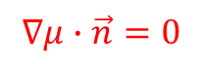
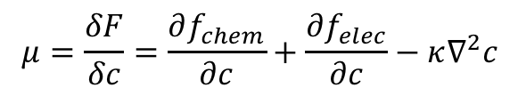
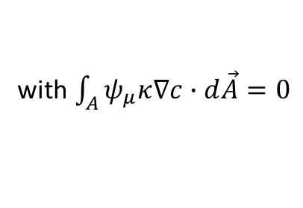
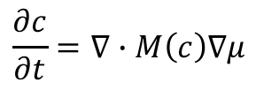
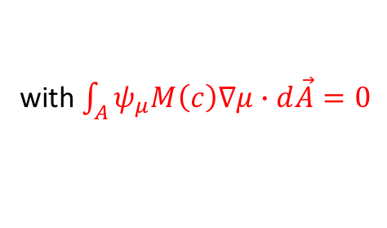
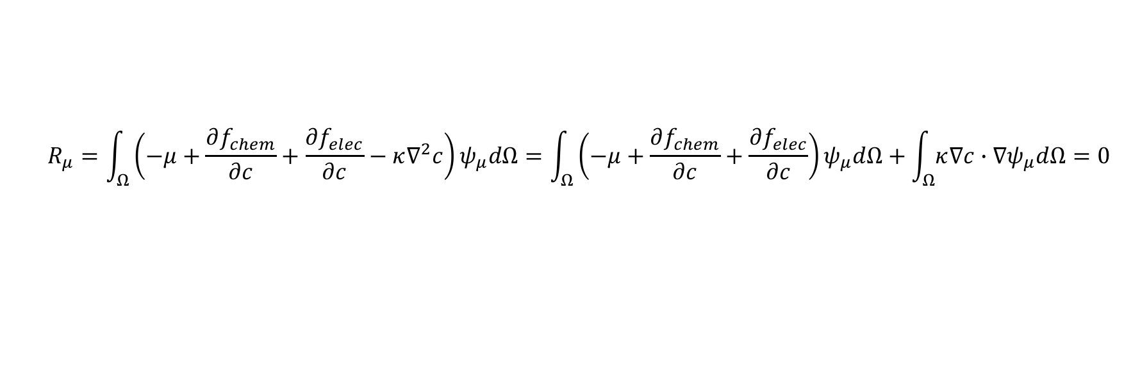
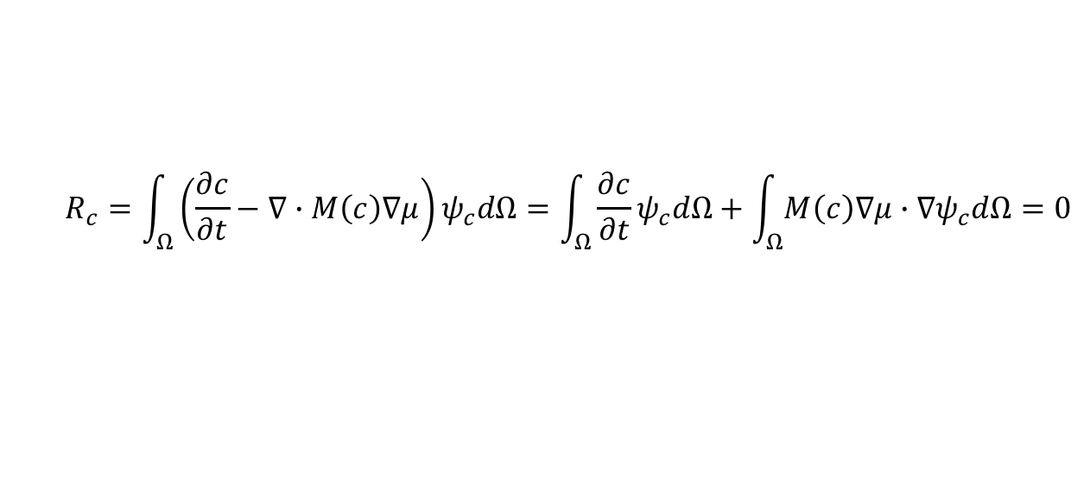
Cahn-Hilliard equation
Strong form
Weak form; ‘forward split’ method
$$\frac{∂c}{∂t}=∇∙M\left(c\right)∇μ$$
$$μ=\frac{δF}{δc}=\frac{∂f_{chem}}{∂c}+\frac{∂f_{elec}}{∂c}−κ∇^{2}c$$
$$∇μ∙\vec{n}=0$$
$$R_{c}=\int_{Ω}^{ }{\left(\frac{∂c}{∂t}−∇∙M\left(c\right)∇μ\right)ψ_{c}dΩ}=\int_{Ω}^{ }{\frac{∂c}{∂t}ψ_{c}dΩ}+\int_{Ω}^{ }{M\left(c\right)∇μ∙∇ψ_{c}dΩ}=0$$
with $\int_{A}^{ }{ψ_{μ}M\left(c\right)∇μ∙d\vec{A}}=0$
$$R_{μ}=\int_{Ω}^{ }{\left(−μ+\frac{∂f_{chem}}{∂c}+\frac{∂f_{elec}}{∂c}−κ∇^{2}c\right)ψ_{μ}dΩ}=\int_{Ω}^{ }{\left(−μ+\frac{∂f_{chem}}{∂c}+\frac{∂f_{elec}}{∂c}\right)ψ_{μ}dΩ+\int_{Ω}^{ }{κ∇c∙∇ψ_{μ}dΩ}=0}$$
with $\int_{A}^{ }{ψ_{μ}κ∇c∙d\vec{A}}=0$

Slide 3
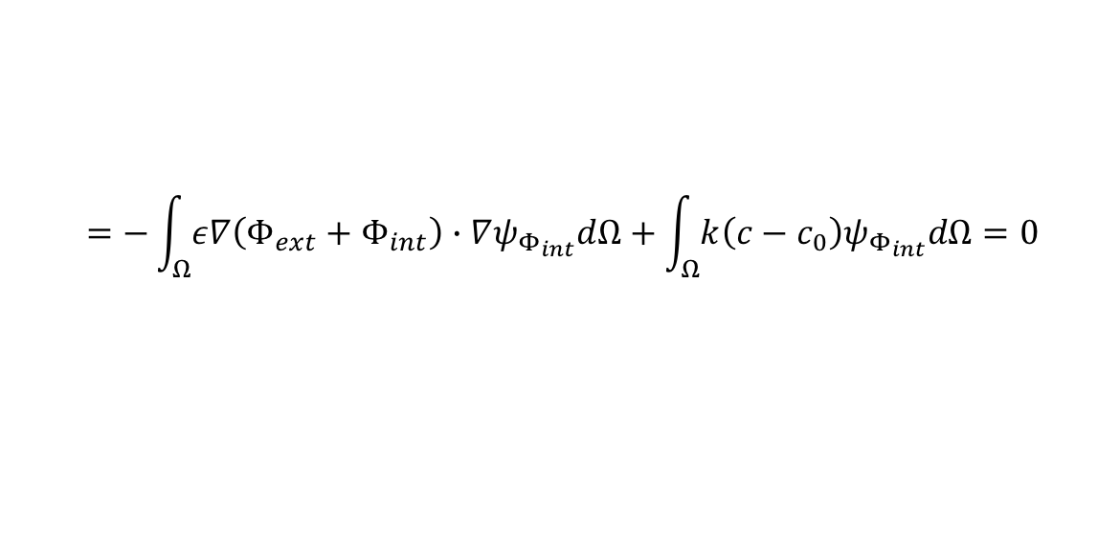
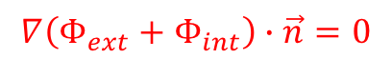

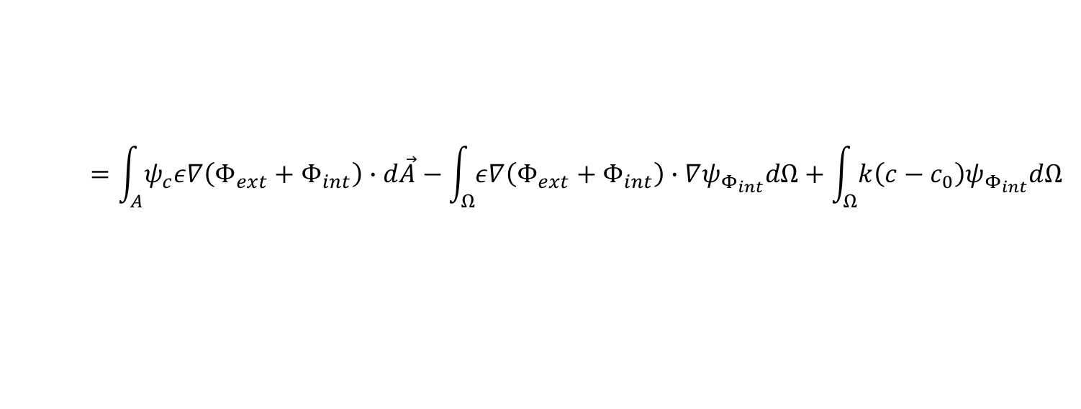
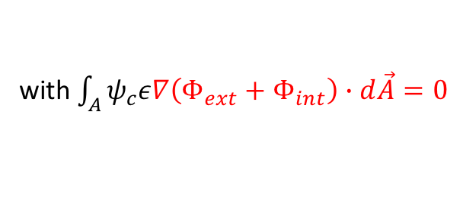
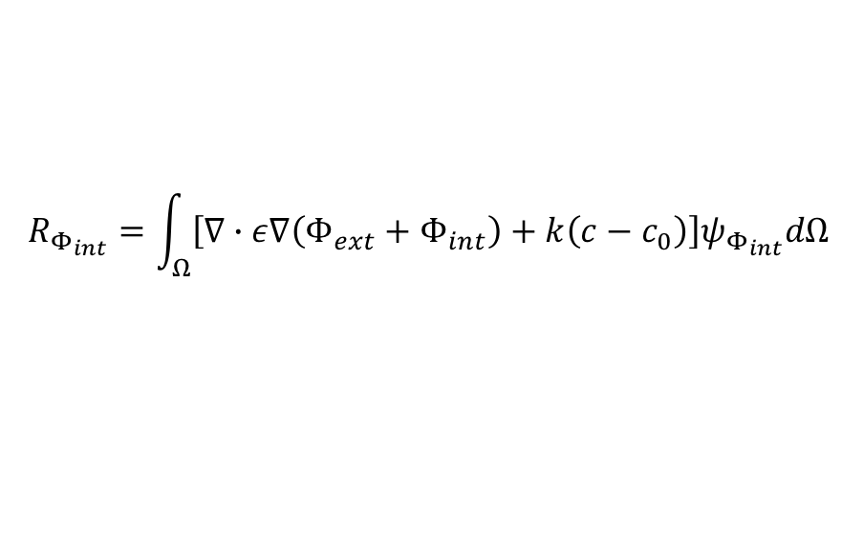
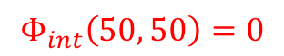
Poisson equation for $Φ_{tot}$; natural BC
Strong form
Weak form
$$∇∙ε∇\left(Φ_{ext}+Φ_{int}\right)=−k\left(c−c_{0}\right)$$
$$R_{Φ_{int}}=\int_{Ω}^{ }{\left[∇∙ε∇\left(Φ_{ext}+Φ_{int}\right)+k\left(c−c_{0}\right)\right]ψ_{Φ_{int}}dΩ}$$
$$=\int_{A}^{ }{ψ_{c}ε∇\left(Φ_{ext}+Φ_{int}\right)∙d\vec{A}}−\int_{Ω}^{ }{ε∇\left(Φ_{ext}+Φ_{int}\right)∙∇ψ_{Φ_{int}}dΩ}+\int_{Ω}^{ }{k\left(c−c_{0}\right)ψ_{Φ_{int}}dΩ}$$
$$=−\int_{Ω}^{ }{ε∇\left(Φ_{ext}+Φ_{int}\right)∙∇ψ_{Φ_{int}}dΩ}+\int_{Ω}^{ }{k\left(c−c_{0}\right)ψ_{Φ_{int}}dΩ}=0$$
with $\int_{A}^{ }{ψ_{c}ε∇\left(Φ_{ext}+Φ_{int}\right)∙d\vec{A}}=0$
$$∇\left(Φ_{ext}+Φ_{int}\right)∙\vec{n}=0$$
$$Φ_{int}\left(50, 50\right)=0$$

Slide 4
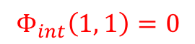
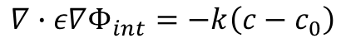
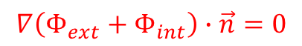

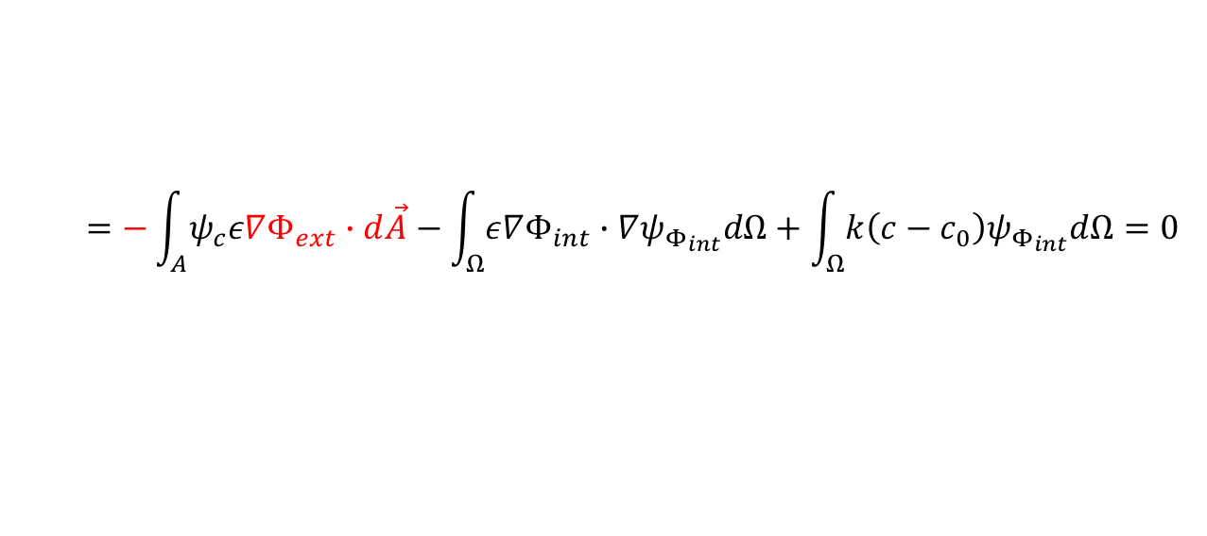

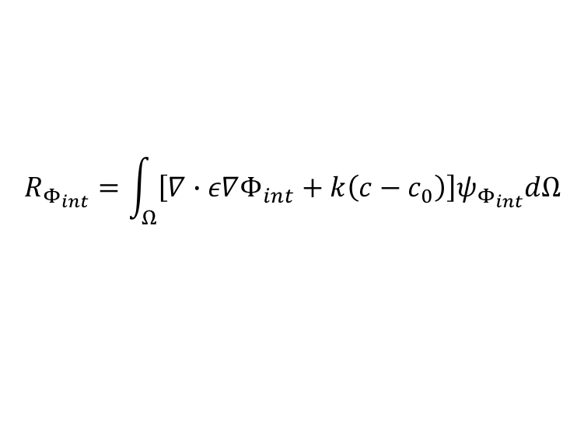
Poisson equation for $Φ_{int}$; Neuman BC
Strong form
Weak form
$$∇∙ε∇Φ_{int}=−k\left(c−c_{0}\right)$$
$$R_{Φ_{int}}=\int_{Ω}^{ }{\left[∇∙ε∇Φ_{int}+k\left(c−c_{0}\right)\right]ψ_{Φ_{int}}dΩ}$$
$$=\int_{A}^{ }{ψ_{c}ε∇Φ_{int}∙d\vec{A}}−\int_{Ω}^{ }{ε∇Φ_{int}∙∇ψ_{Φ_{int}}dΩ}+\int_{Ω}^{ }{k\left(c−c_{0}\right)ψ_{Φ_{int}}dΩ}=0$$
$$=−\int_{A}^{ }{ψ_{c}ε∇Φ_{ext}∙d\vec{A}}−\int_{Ω}^{ }{ε∇Φ_{int}∙∇ψ_{Φ_{int}}dΩ}+\int_{Ω}^{ }{k\left(c−c_{0}\right)ψ_{Φ_{int}}dΩ}=0$$
$$∇\left(Φ_{ext}+Φ_{int}\right)∙\vec{n}=0$$
$$Φ_{int}\left(1, 1\right)=0$$

Slide 5

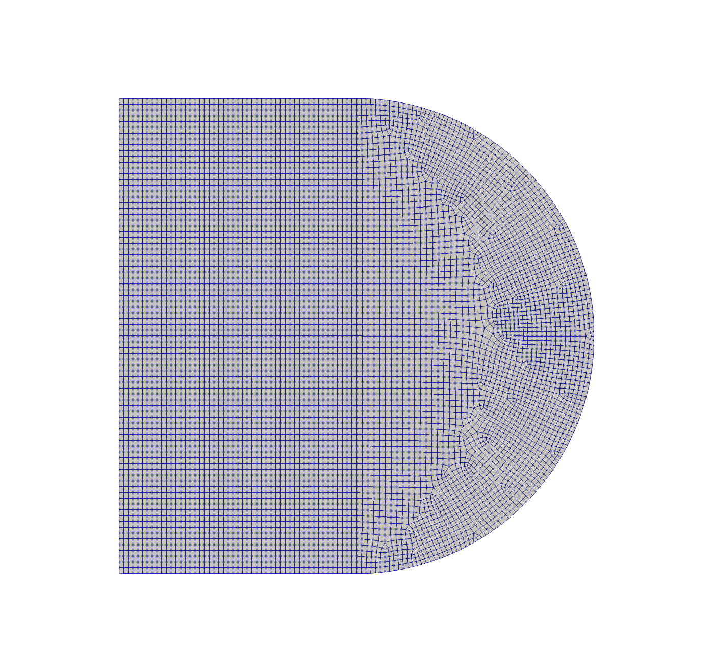
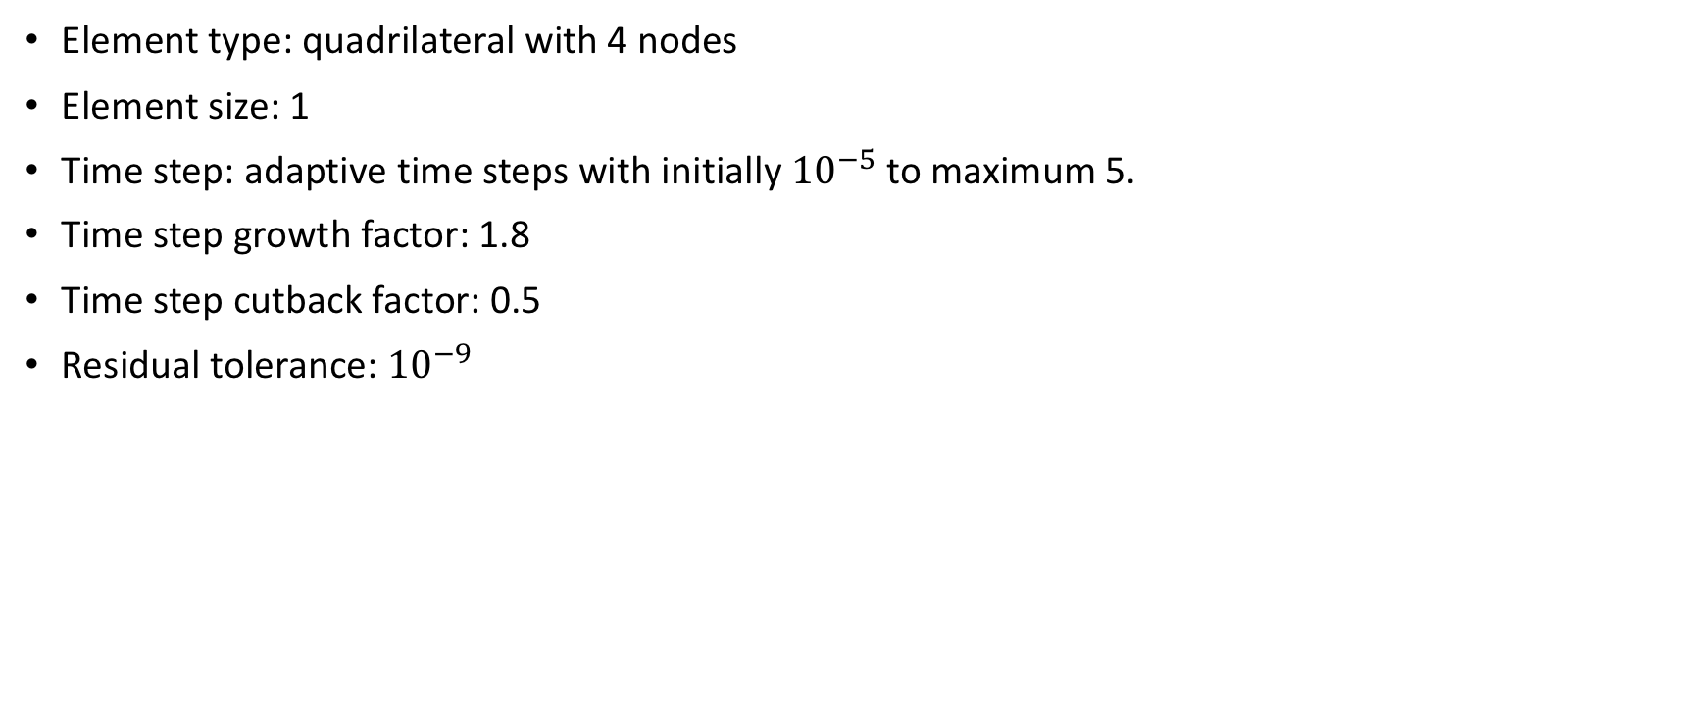
Discretization & numerical parameters
Element type: quadrilateral with 4 nodes
Element size: 1
Time step: adaptive time steps with initially ${10}^{−5}$ to maximum 5.
Time step growth factor: 1.8
Time step cutback factor: 0.5
Residual tolerance: ${10}^{−9}$
(a)
(b)

Slide 6
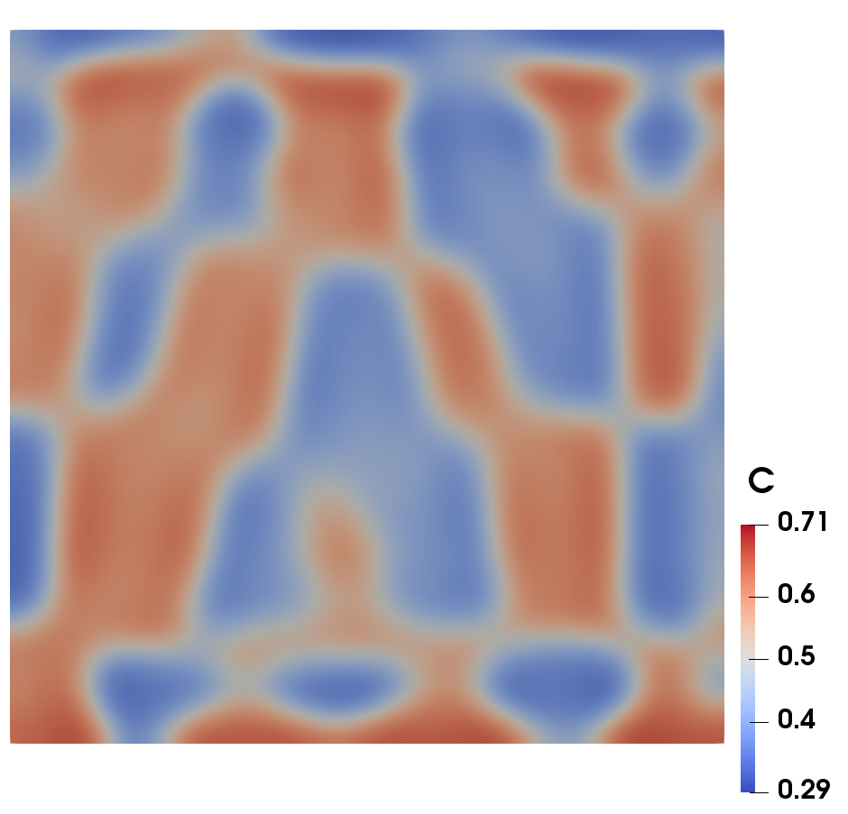
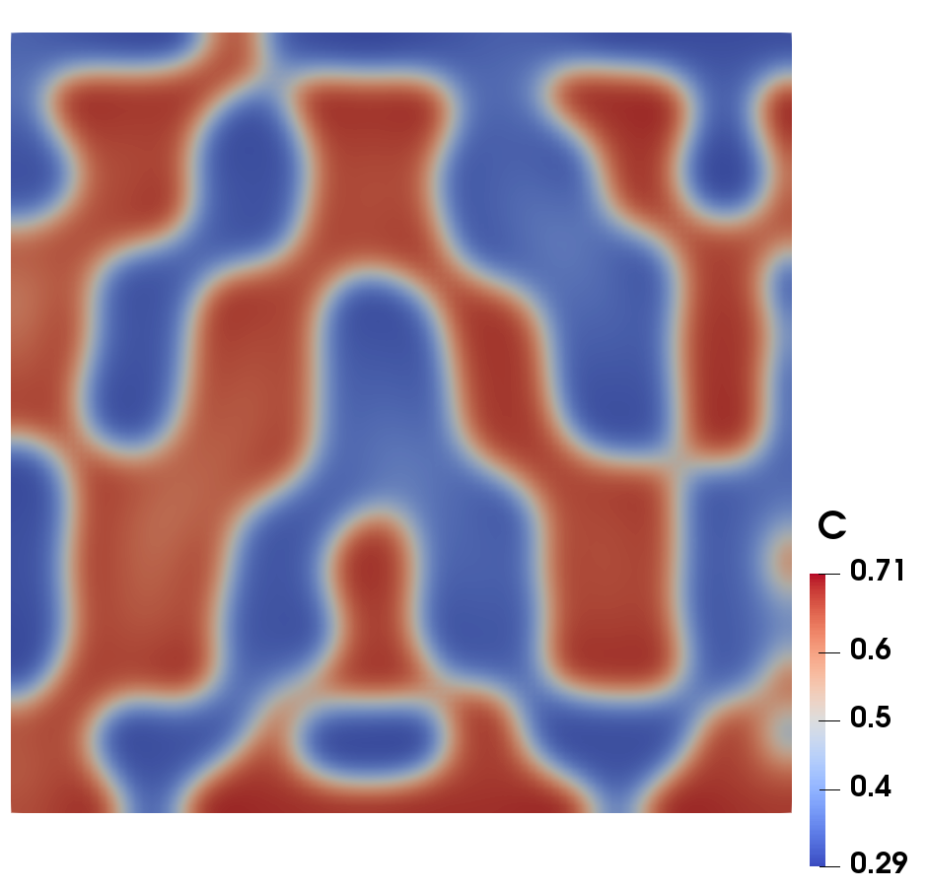
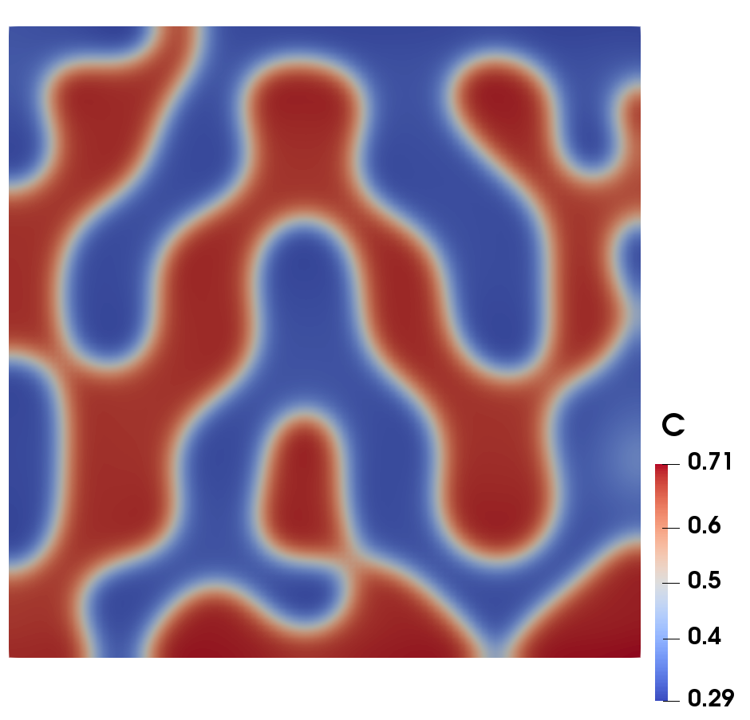
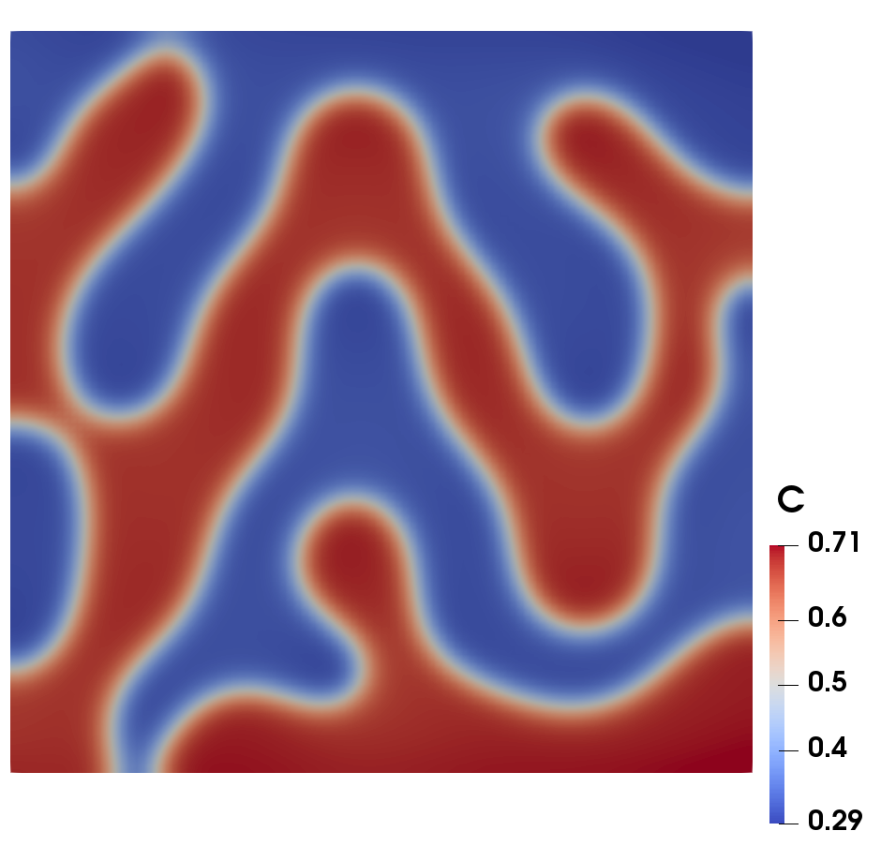
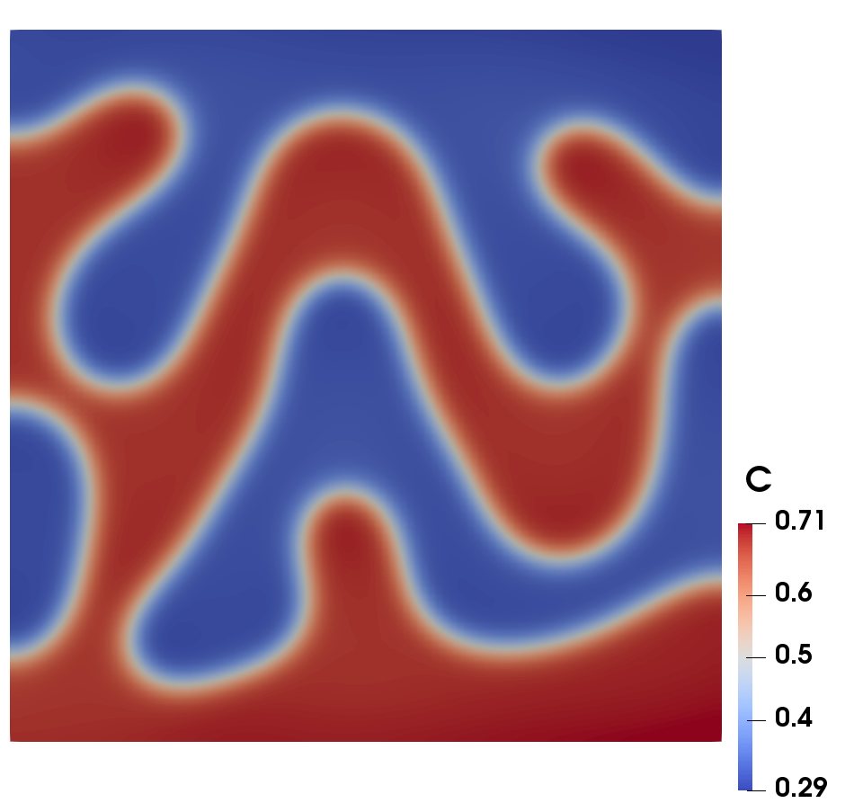
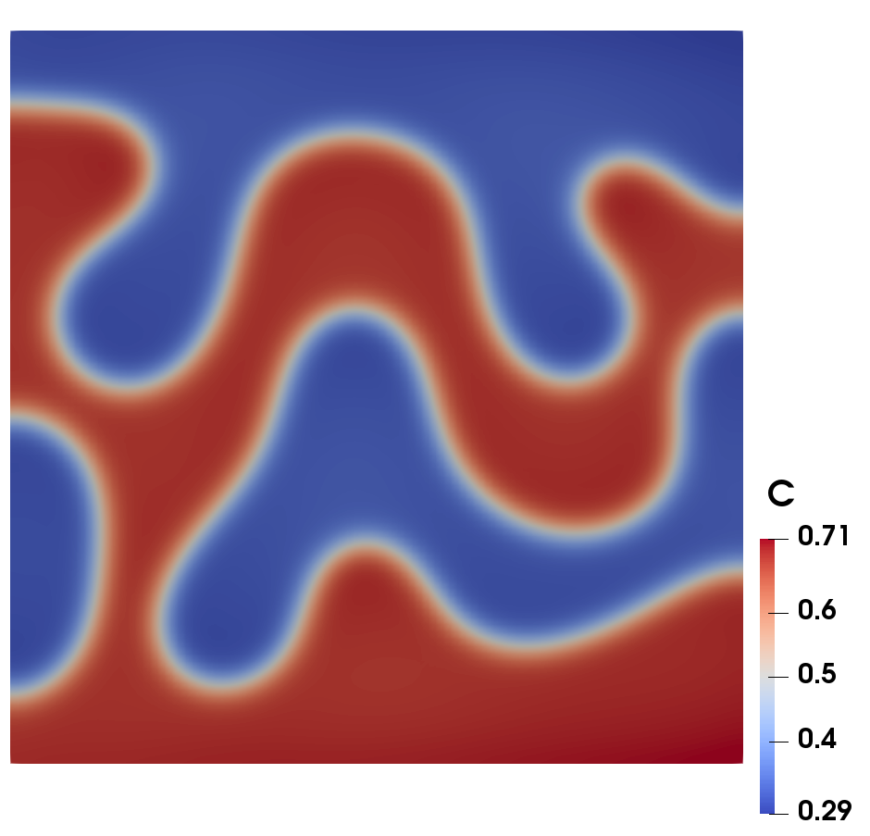
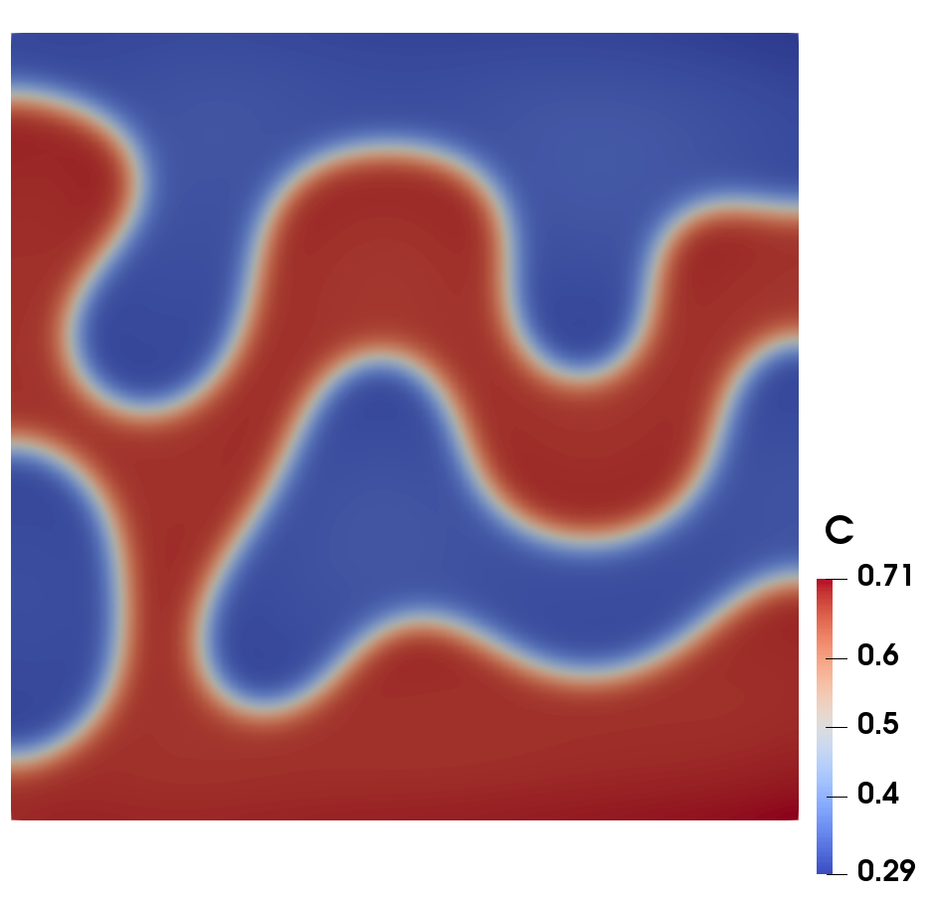
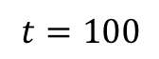
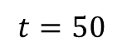
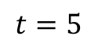
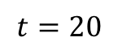
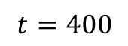
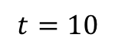
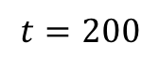
Results for (a) with function Neumann B.C: concentration field
$$t=5$$
$$t=10$$
$$t=20$$
$$t=50$$
$$t=100$$
$$t=200$$
$$t=400$$

Slide 7
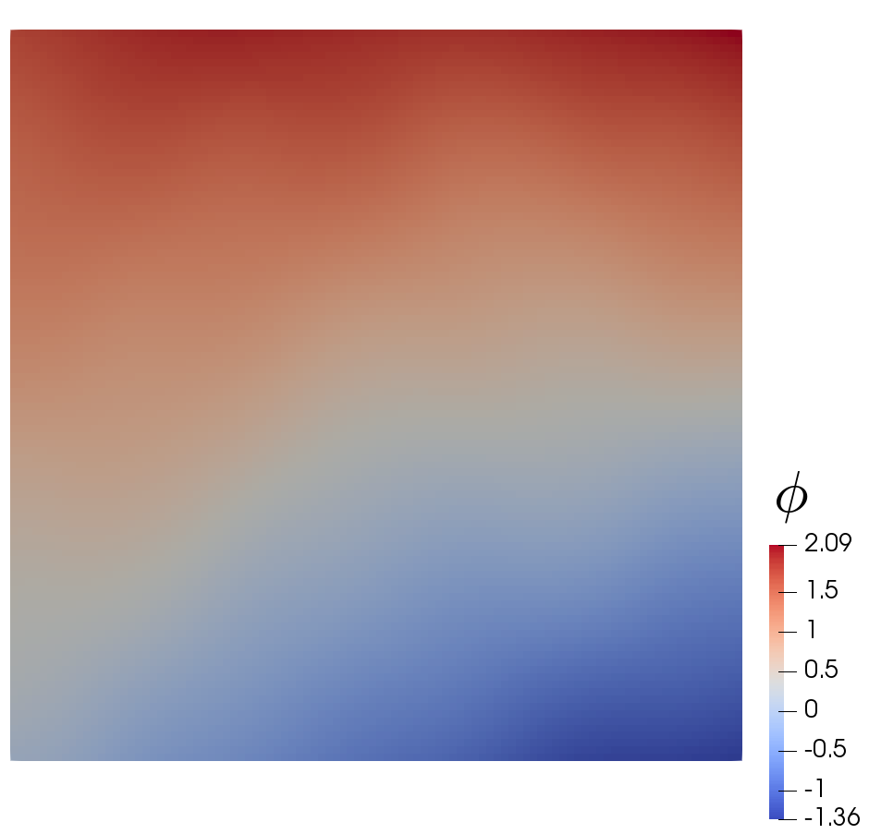
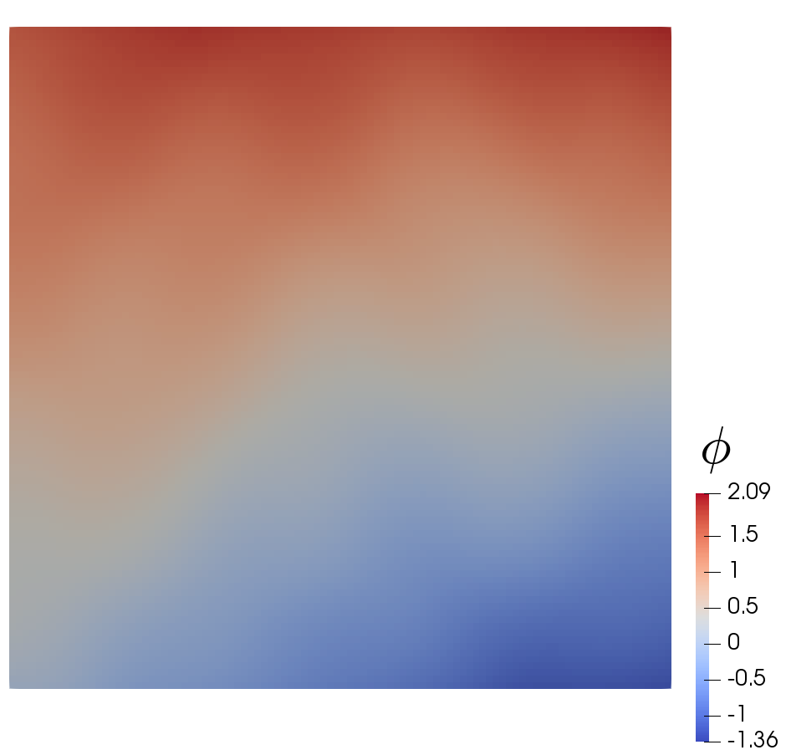
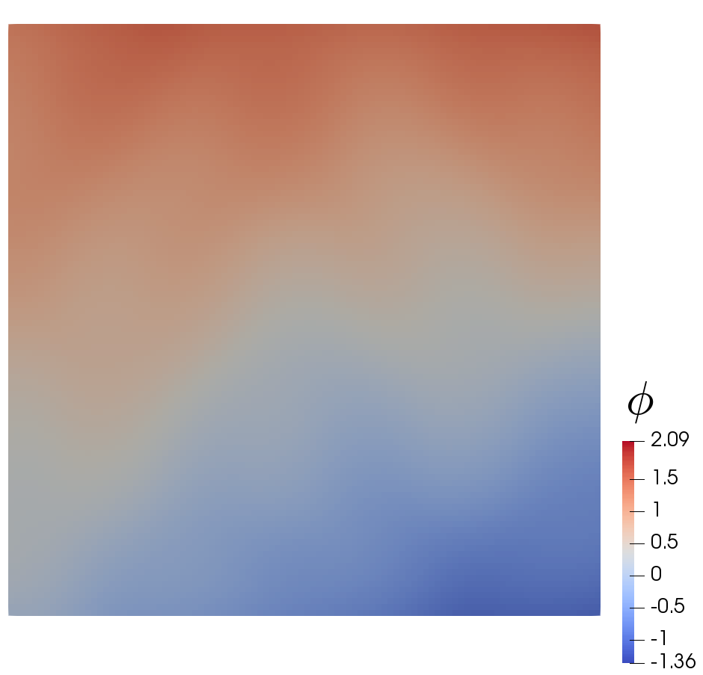
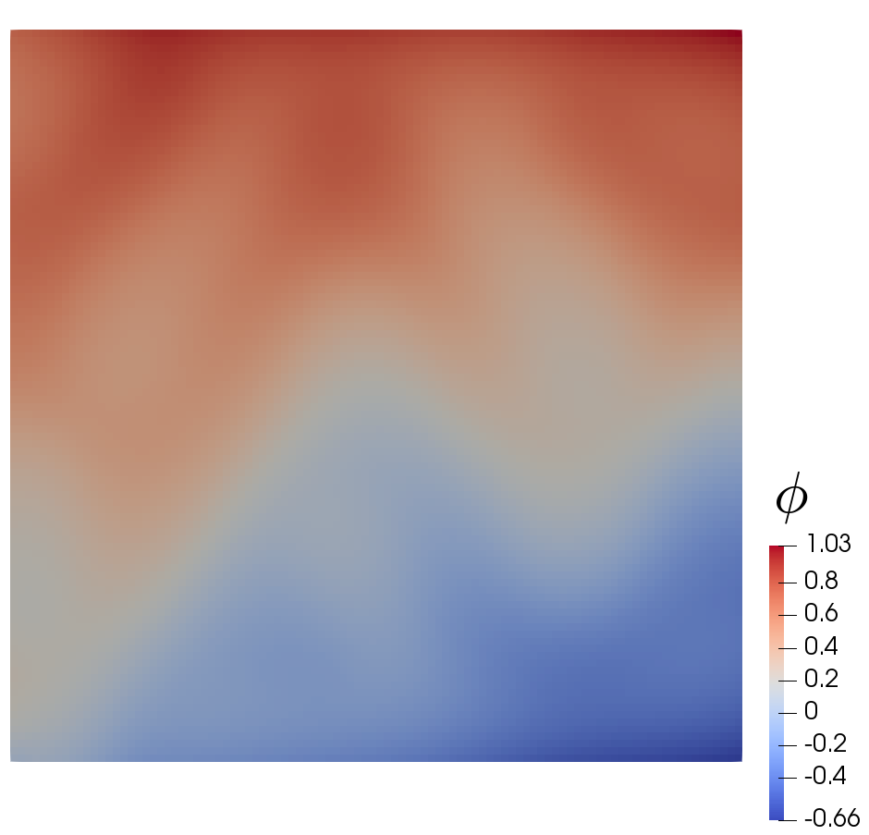
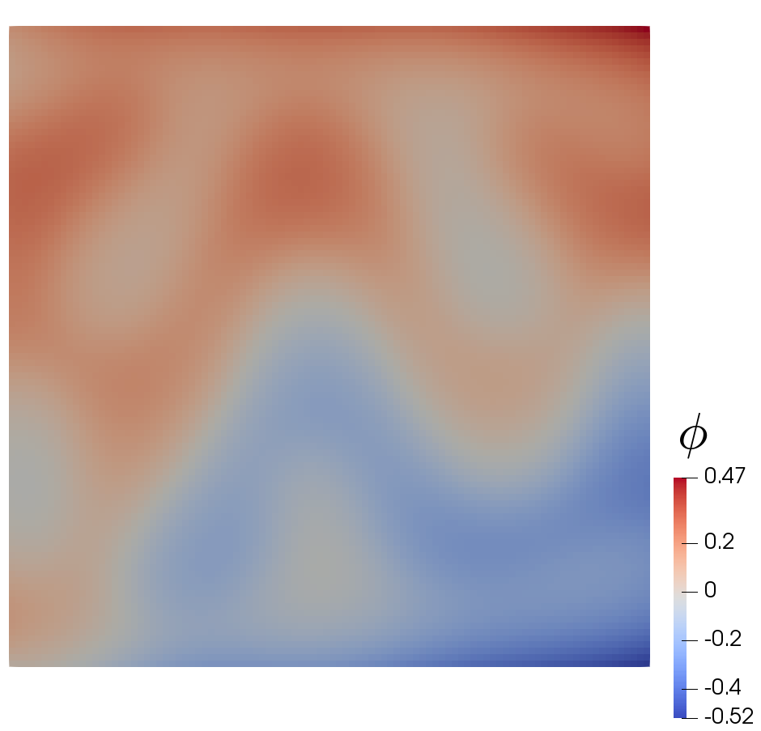
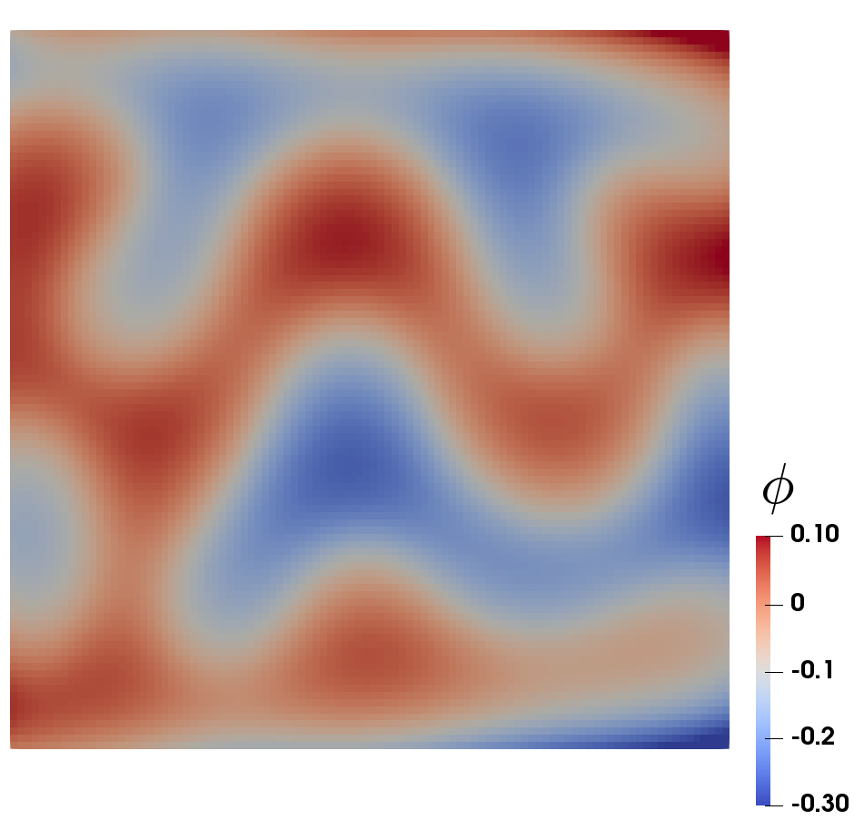
Results for (a)-Function Neumann B.C: Electric potential field
$$t=5$$
$$t=10$$
$$t=20$$
$$t=50$$
$$t=100$$
$$t=200$$
$$t=400$$

Slide 8
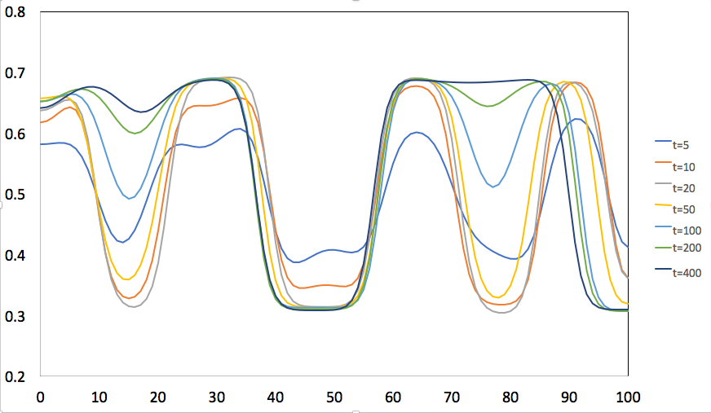
Results for (a)-Function Neumann B.C: cross-sectional concentration

Slide 9
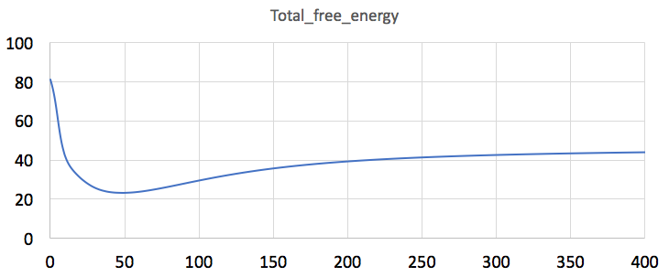
Results for (a)- Function Neumann B.C. total free energy

Slide 10
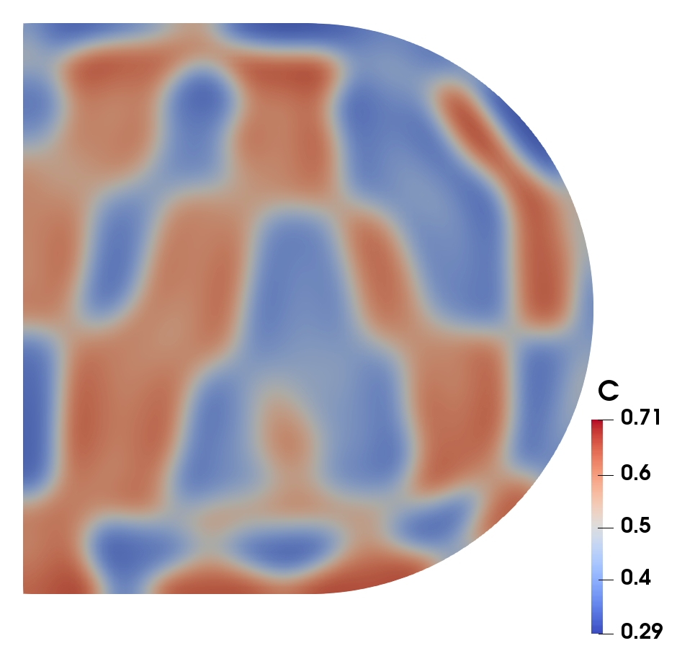
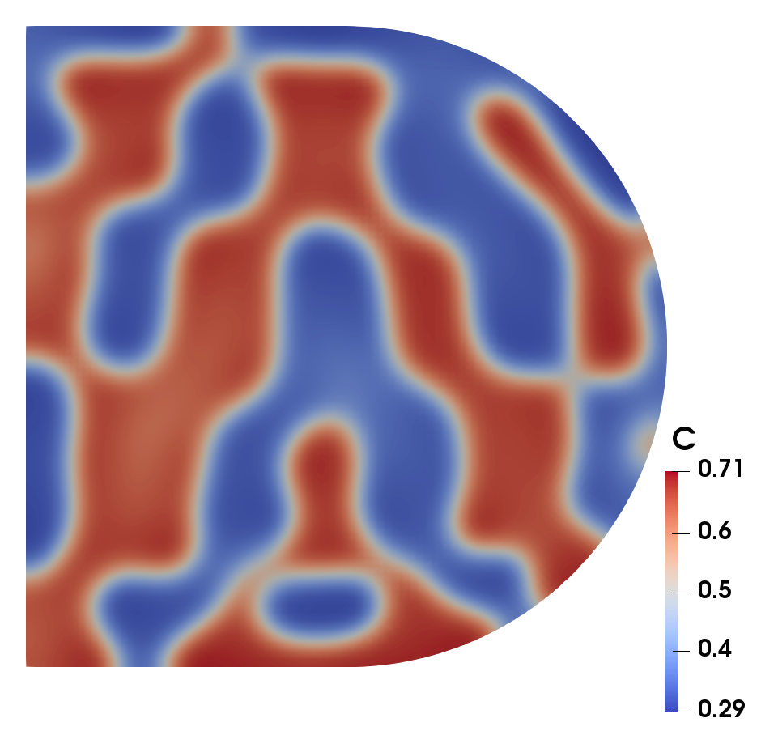
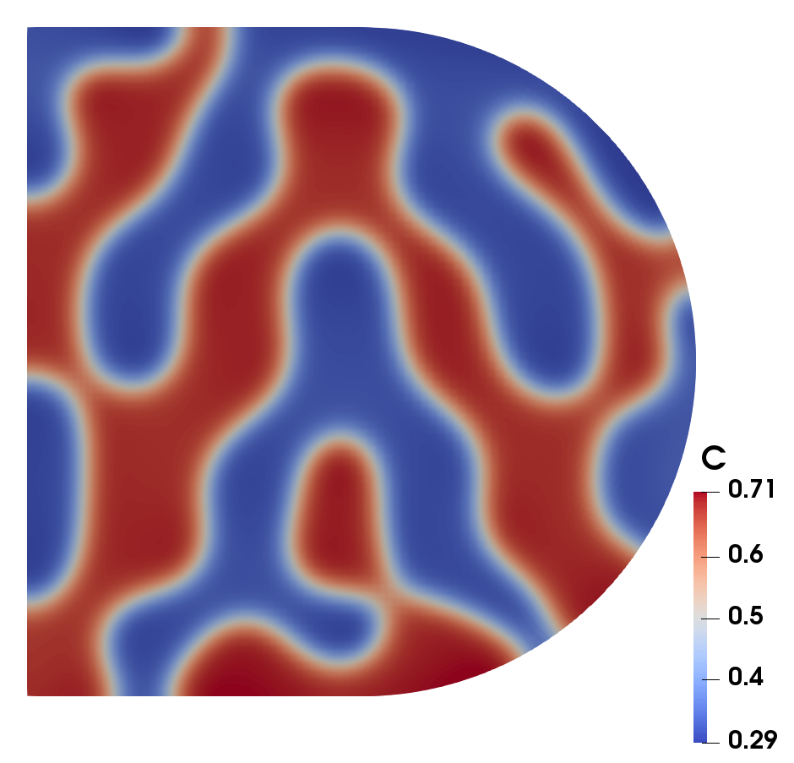
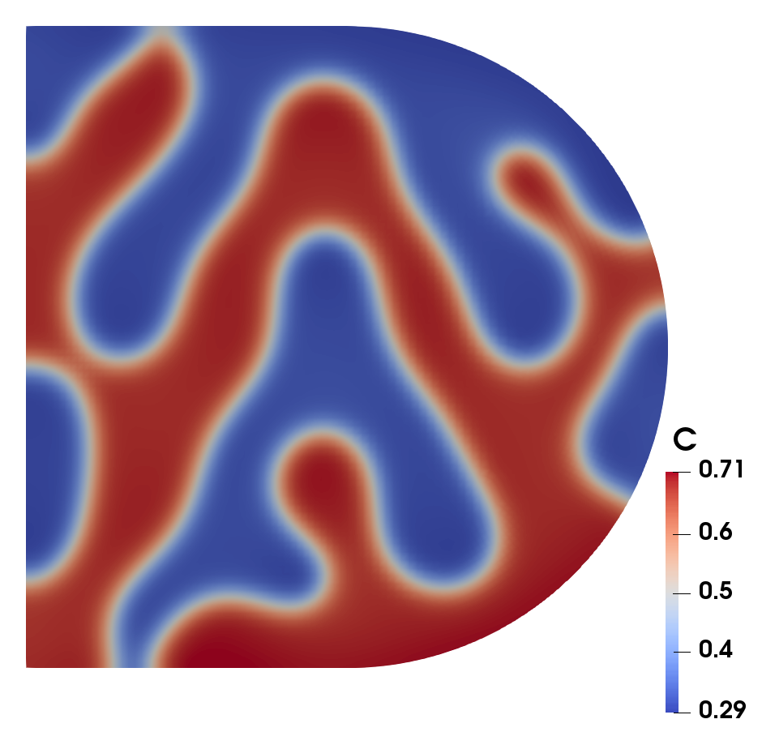
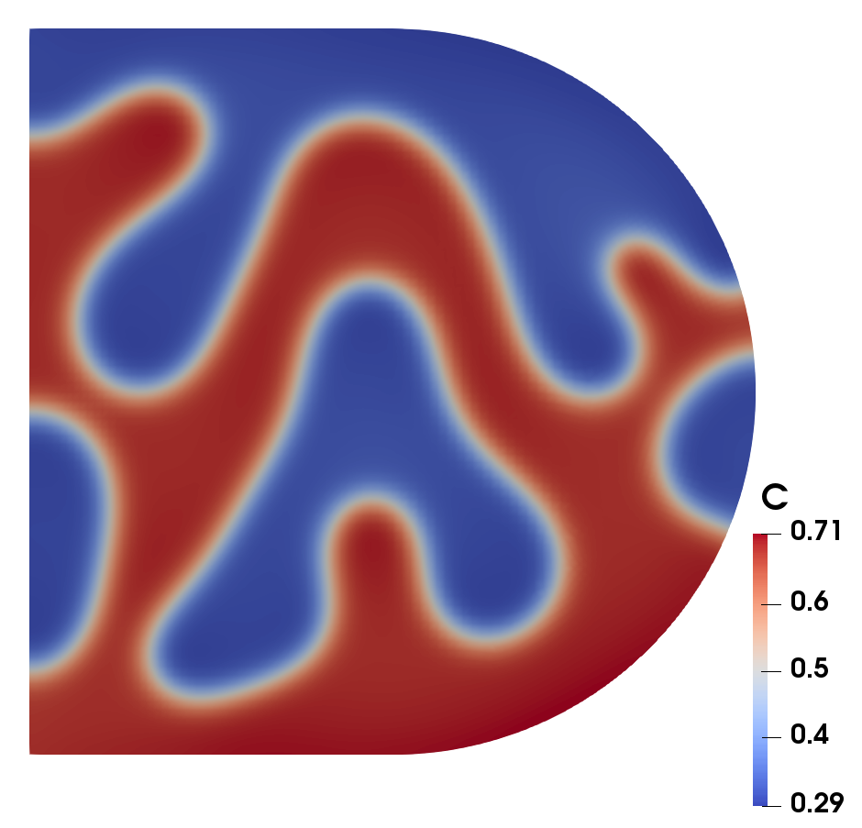
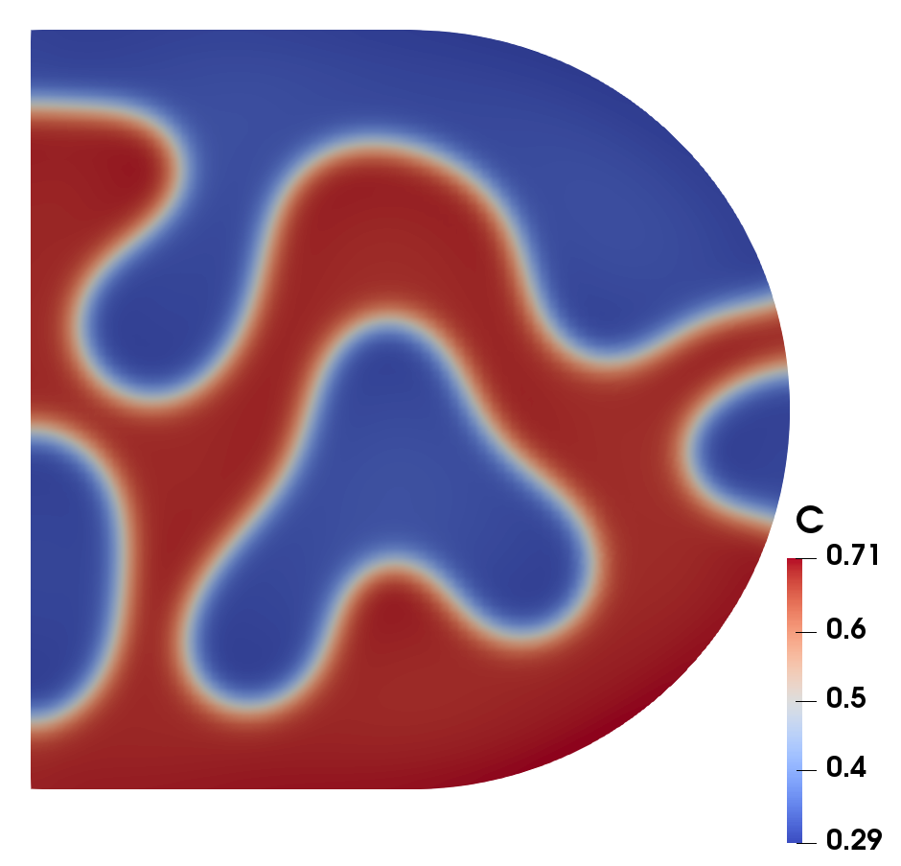
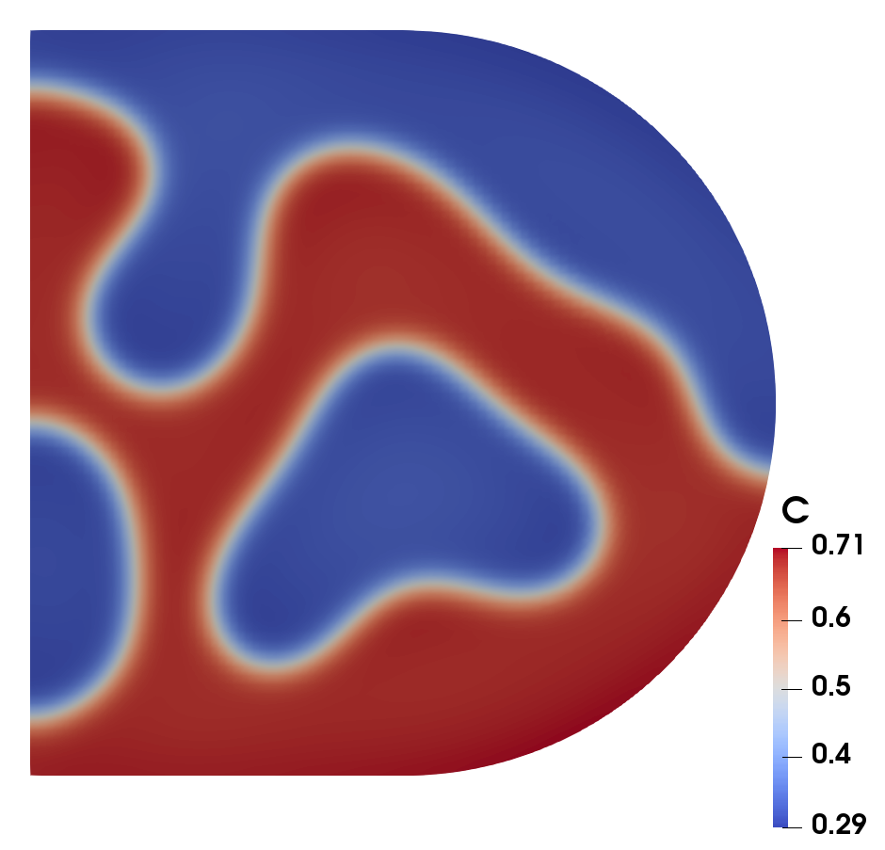
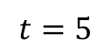
Results for (b)—Neumann B.C.: concentration field
$$t=5$$
$$t=10$$
$$t=20$$
$$t=50$$
$$t=100$$
$$t=200$$
$$t=400$$

Slide 11







Results for (b): concentration field
$$t=5$$
$$t=10$$
$$t=20$$
$$t=50$$
$$t=100$$
$$t=200$$
$$t=400$$

Slide 12







Results for (b)—Neumann B.C. Electric potential field
$$t=5$$
$$t=10$$
$$t=20$$
$$t=50$$
$$t=100$$
$$t=200$$
$$t=400$$

Slide 13

Results for (b)—Neuman B.C.: cross-sectional concentration

Slide 14

Results for (b)—Neumann B.C. total free energy

Slide 15







Results for (a): concentration field
$$t=5$$
$$t=10$$
$$t=20$$
$$t=50$$
$$t=100$$
$$t=200$$
$$t=400$$

Slide 16







Results for (a): Electric potential field
$$t=5$$
$$t=10$$
$$t=20$$
$$t=50$$
$$t=100$$
$$t=200$$
$$t=400$$

Slide 17
Results for (a): cross-sectional concentration

Slide 18
Results for (a): total free energy

Slide 19







Results for (b): Electric potential field
$$t=5$$
$$t=10$$
$$t=20$$
$$t=50$$
$$t=100$$
$$t=200$$
$$t=400$$

Slide 20
Results for (b): cross-sectional concentration

Slide 21
Results for (b): total free energy

Slide 22




Discussion about total free energy change
$$F=\int_{V}{\frac{κ}{2}{\left|∇c\right|}^{2}+f_{chem}\left(c\right)+f_{elec}\left(c, Φ\right)dV}$$
$$\frac{∂F}{∂t}=\int_{V}{μ\frac{∂c}{∂t}+\frac{δF}{δΦ}\frac{∂Φ}{∂t}dV}=\int_{V}{μ∇∙M∇μ+\frac{ρ_{tot}}{2}\frac{∂Φ}{∂t}dV}$$
$$=\int_{V}{−M{\left(∇μ\right)}^{2}+\frac{1}{2}ε∇^{2}Φ\frac{∂Φ}{∂t}dV}=\int_{V}{−M{\left(∇μ\right)}^{2}−\frac{1}{2}ε∇Φ∙\frac{∂∇Φ}{∂t}dV}$$
$$=\int_{V}{−M{\left(∇μ\right)}^{2}−\frac{1}{4}ε\frac{∂}{∂t}{\left(∇Φ\right)}^{2}dV}$$
Is this always positive?

Slide 23







Discussion about electrostatic free energy density
$$ε∇^{2}Φ=−k\left(c−c_{0}\right)$$
With BC:
$$∇Φ∙\vec{n}=0$$
$$ε∇^{2}\left(Φ+C\right)=−k\left(c−c_{0}\right)$$
$$∇\left(Φ+C\right)∙\vec{n}=0$$
$C$: arbitrary constant
$$f_{elec}\left(c, Φ\right)=\frac{1}{2}k\left(c−c_{0}\right)\left(Φ+C\right)$$
Probably we need to take control of $C$.

